Slide 1
Java Fundamentals

Slide 2
Course objectives
Introduction to Java
Basic Java Syntax
Array
Parameter
String
Flow Control

Slide 3
Learning Approach
The following are strongly suggested for a better learning and understanding of this course:
  Noting down the key concepts in the class
  Analyze all the examples / code snippets provided
  Study and understand the self study topics
  Completion and submission of all the assignments, on time
  Completion of the self review questions in the lab guide
  Study and understand all the artifacts including the reference materials / e-learning / supplementary materials specified
  Completion of the project (if application for this course) on time inclusive of individual and group activities
  Taking part in the self assessment activities
  Participation in the doubt clearing sessions

Slide 4
Session 1: Introduction to Java

Slide 5
Introduction to Java
A programming language that was introduced by Sun Microsystems in 1995
Originally for intelligent consumer-electronic devices
Then used for creating Web pages with dynamic content
Now also used for:
  Develop large-scale enterprise applications
  Enhance WWW server functionality
  Provide applications for consumer devices (cell phones, etc.)
Object-oriented programming
Java Tutorial Online at http://download.oracle.com/javase/tutorial/java/index.html

Slide 6
Java Principles
It should be "simple, object oriented, and familiar".
It should be "robust and secure".
It should have "an architecture-neutral and portable environment".
It should execute with "high performance".
It should be "interpreted, threaded, and dynamic".

Slide 7
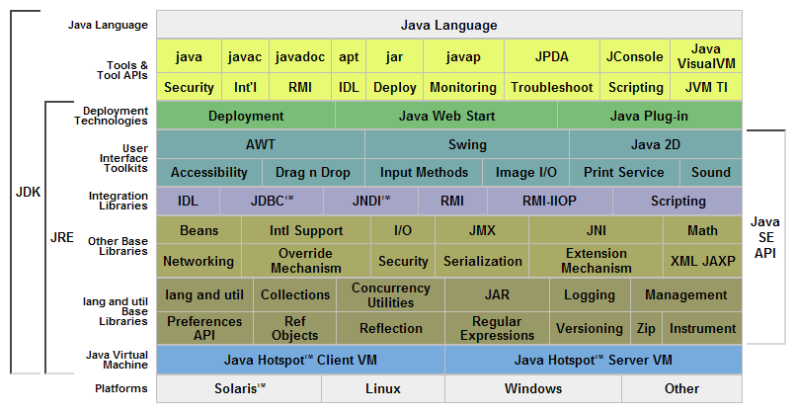
Java Platform

Slide 8
Basics of a Typical Java Environment
Phase 1
Editor
Program is created in an editor and stored on disk in a file ending with .java.
Disk
Phase 2
Compiler
Disk
Compiler creates bytecodes and stores them on disk in a file ending with .class.
Primary
Memory
Phase 3
Class Loader
Class loader reads .class files containing bytecodes from disk and puts those bytecodes in memory.
Disk
.
.
.
.
.
.
Primary
Memory
Phase 4
Bytecode Verifier
Bytecode verifier confirms that all bytecodes are valid and do not violate Java’s security restrictions.
.
.
.
.
.
.
Primary
Memory
Interpreter reads bytecodes and translates them into a language that the computer can understand, possibly storing data values as the program executes.
Phase 5
Interpreter
.
.
.
.
.
.

Slide 9
First Sample: Printing a Line of Text
// This is a simple program called First.java
class First {
public static void main (String [] args) {
System.out.println ("My first program in Java ");
}
}
Notes:
Application: Program that executes using the java interpreter
Sample program: Show program, then analyze each line

Slide 10
Analyzing the Java Program
The symbol // stands for commented line.
The line class First declares a new class called First.
public static void main (String [] args)
  This is the main method from where the program begins its execution.
System.out.println (“My first program in java”);
  This line displays the string My first program in java on the screen.

Slide 11
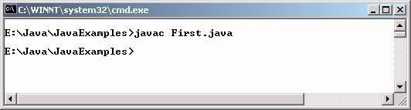
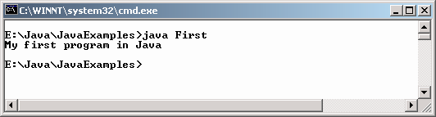
Compiling and executing
The java compiler creates a file called 'First.class' that contains the byte codes
To actually run the program, a java interpreter called java is required to execute the code.

Slide 12
Passing Command Line Arguments
class CommLineArg
{
public static void main (String [] pargs)
{
System.out.println("These are the arguments passed to the main method.");
System.out.println(pargs [0]);
System.out.println(pargs [1]);
System.out.println(pargs [2]);
}
}

Slide 13
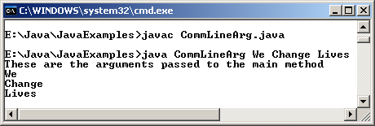
Passing Command Line Arguments

Slide 14
Summary
Java is an OOP programming language, developed by Sun Microsystems
Mostly use for enterprise web application
Write Once, Run Anywhere

Slide 15
Session 2: Basic Java Syntax

Slide 16
Code Comment
/*
* Multi line
*/
// Single line
/**
* Special comment for Javadocs
*/
Notes:
Comment should be meaningful, not repeat the code.

Slide 17
Name Styles
In Java, names are case-sensitive, may contains letter, number, the dollar sign "$", or the underscore character "_".
Some convention name styles:
Class names: CustomerInfo
Variable, function names: basicAnnualSalary
Constants name: MAXIMUM_NUM_OF_PARTICIPANTS

Slide 18
Naming best practice
Name should be meaningful
Avoid very sort name, except for temporary "throwaway" variables: a, i, j
Avoid confuse name: TransferAction class and DoTransferAction class, so which one will really performs the action?
Class name should be a noun, use whole words, avoid acronyms and abbreviations: Student
Variable name should begin with a noun: numberOfFiles
Variable names should not start with underscore ('_') or dollar sign ('$') characters, even though both are allowed.
Distinguish singular - plural: Student - Students
Method name should begin with verb: countNumberOfFiles()
As clear as possible: annualSalary instead of salary
Avoid mixed-language, ex Vietnamese + English + Japanese.
Notes:
Teacher may talk more about some other best practice in naming convention

Slide 19
Java Keywords
abstract | continue | for | new | switch
assert*** | default | goto* | package | synchronized
boolean | do | if | private | this
break | double | implements | protected | throw
byte | else | import | public | throws
case | enum**** | instanceof | return | transient
catch | extends | int | short | try
char | final | interface | static | void
class | finally | long | strictfp** | volatile
const* | float | native | super | while
* | not used
** | added in 1.2
*** | added in 1.4
**** | added in 5.0
true, false, and null might seem like keywords, but they are actually literals; you cannot use them as identifiers in your programs.
Notes:
Don’t use these keywords as variable names, class names, etc

Slide 20
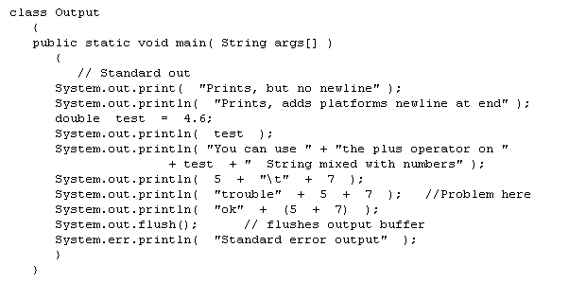
Standard Java Output
System.out is standard out in Java
System.err is error out in Java

Slide 21
Standard Java Input
System.in is standard input in Java
    The following program reads characters from the keyboard then print out to the screen.
// Echo.java
class Echo {
public static void main (String[] args) throws IOException {
int ch;
System.out.println("Enter some text: ");
while ((ch = System.in.read()) != '\n') {
System.out.print((char)ch);
}
}
}

Slide 22
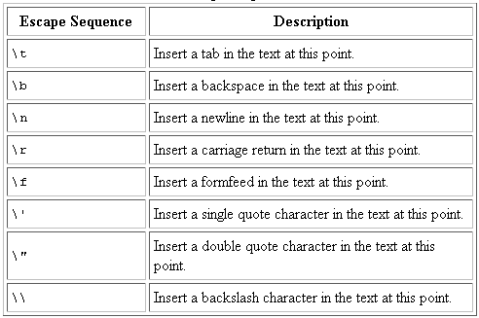
Escape characters
Escape characters is backslash ( \ )

Slide 23
Basic Data Types
byte: The byte data type is an 8-bit signed two's complement integer. It has a minimum value of -128 and a maximum value of 127 (inclusive).
short: The short data type is a 16-bit signed two's complement integer. It has a minimum value of -32,768 and a maximum value of 32,767 (inclusive)
int: The int data type is a 32-bit signed two's complement integer. It has a minimum value of -2,147,483,648 and a maximum value of 2,147,483,647 (inclusive).
long: The long data type is a 64-bit signed two's complement integer. It has a minimum value of -9,223,372,036,854,775,808 and a maximum value of 9,223,372,036,854,775,807 (inclusive)
Notes:
A primitive type is predefined by the language and is named by a reserved keyword. Primitive values do not share state with other primitive values.

Slide 24
Basic Data Types (cont.)
float: The float data type is a single-precision 32-bit IEEE 754 floating point. Its range of values is from 1.4E⁻⁴⁵ to 3.4028235E³⁸
double: The double data type is a double-precision 64-bit IEEE 754 floating point. Its range of values is from 4.9E⁻³²⁴ to 1.7976931348623157E³⁰⁸
boolean: The boolean data type has only two possible values: true and false. Use this data type for simple flags that track true/false conditions. This data type represents one bit of information, but its "size" isn't something that's precisely defined.
char: The char data type is a single 16-bit Unicode character. It has a minimum value of '\u0000' (or 0) and a maximum value of '\uffff' (or 65,535 inclusive).
Notes:
A primitive type is predefined by the language and is named by a reserved keyword. Primitive values do not share state with other primitive values.

Slide 25
Operations
Simple Assignment Operator
  = Simple assignment operator
Arithmetic Operators
  + Additive operator
  - Subtraction operator
  * Multiplication operator
  / Division operator
  % Remainder operator
Unary Operators
  + Unary plus operator; indicates positive value
  - Unary minus operator; negates an expression
  ++ Increment operator; increments a value by 1
  -- Decrement operator; decrements a value by 1
  ! Logical compliment operator; inverts the value of a boolean

Slide 26
Operations (cont)
Equality and Relational Operators
  == Equal to
  != Not equal to
  > Greater than
  >= Greater than or equal to
  < Less than
  <= Less than or equal to
Conditional Operators
  && Conditional-AND
  || Conditional-OR
  ?: Ternary (shorthand for if-then-else statement)
Type Comparison Operator
  instanceof Compares an object to a specified type

Slide 27
Operations (cont)
Bitwise and Bit Shift Operators
  ~ Unary bitwise complement
  << Signed left shift
  >> Signed right shift
  >>> Unsigned right shift
  & Bitwise AND
  ^ Bitwise exclusive OR
  | Bitwise inclusive OR

Slide 28
Operator Precedence
Operators | Precedence
postfix | expr++ expr--
unary | ++expr --expr +expr -expr ~ !
multiplicative | * / %
additive | + -
shift | << >> >>>
relational | < > <= >= instanceof
equality | == !=
bitwise AND | &
bitwise exclusive OR | ^
bitwise inclusive OR | |
logical AND | &&
logical OR | ||
ternary | ? :
assignment | = += -= *= /= %= &= ^= |= <<= >>= >>>=
Notes:
The operators in the following table are listed according to precedence order. The closer to the top of the table an operator appears, the higher its precedence. Operators with higher precedence are evaluated before operators with relatively lower precedence. Operators on the same line have equal precedence. When operators of equal precedence appear in the same expression, a rule must govern which is evaluated first. All binary operators except for the assignment operators are evaluated from left to right; assignment operators are evaluated right to left.

Slide 29
Assignment in Java
In Java, = is always “shallow”, mean copying the pointer but not the value. Sample:
public class Foo {
private int x;
public Foo(int x) {
this.x = x;
}
public int getValue() {
return x;
}
public void setValue(int value) {
this.x = value;
}
}

Slide 30
Assignment in Java (cont)
public class Sample {
public static void main(String args[]) {
Sample sample = new Sample();
Foo f1 = new Foo(5);
Foo f2 = new Foo(20);
System.out.println("F1 Before: " + f1.getValue());
System.out.println("F2 Before: " + f2.getValue());
f1 = f2; // Assign f1 to f2
sample.increase(f1, 10); // Change f1 value
System.out.println("F1 After: " + f1.getValue());
System.out.println("F2 After: " + f2.getValue());
}
public void increase(Foo foo, int value) {
foo.setValue(foo.getValue() + value);
}
}
Output:
F1 Before: 5
F2 Before: 20
F1 After: 30
F2 After: 30

Slide 31
Type Casting
In type casting, a data type is converted into another data type.
Example
    float c = 34.89675f;
    int b = (int)c + 10;

Slide 32
Automatic type and Casting
There are two type of data conversion: automatic type conversion and casting.
When one type of data is assigned to a variable of another type then automatic type conversion takes place provided it meets the conditions specified:
  The two types are compatible
  The destination type is larger than the source type.
Casting is used for explicit type conversion. It loses information above the magnitude of the value being converted.

Slide 33
Type Promotion Rules
All byte and short values are promoted to int type.
If one operand is long, the whole expression is promoted to long.
If one operand is float then the whole expression is promoted to float.
If one operand is double then the whole expression is promoted to double.

Slide 34
Variables
Three components of a variable declaration are:
  Data type
  Name
  Initial value to be assigned (optional)
Syntax
  datatype identifier [=value][, identifier[=value]...];

Slide 35
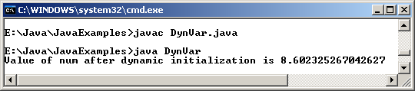
Example
class DynVar {
public static void main(String[] args) {
double len = 5.0, wide = 7.0;
double num = Math.sqrt(len * len + wide * wide);
System.out.println("Value of num after dynamic initialization is " + num);
}
}

Slide 36
Scope and Lifetime of Variables
Variables can be declared inside a block.
The block begins with an opening curly brace and ends with a closing curly brace.
A block defines a scope.
A new scope is created every time a new block is created.
Scope specifies what objects are visible to other parts of the program.
It also determines the life of an object.

Slide 37
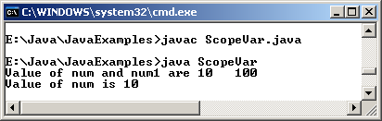
Example
class ScopeVar {
public static void main(String[] args) {
int num = 10;
if ( num == 10) {
// num is available in inner scope
int num1 = num * num;
System.out.println("Value of num and num1 are " + num + " " + num1);
}
//num1 = 10; ERROR ! num1 is not known
System.out.println("Value of num is " + num);
}
}

Slide 38
Summary
The syntax of Java is largely derived from C++
All code is written inside a class, and everything is an object.
Keywords (50)
Primitive data type (8)
Operations (28)
Variable and scope
Notes:
With the exception of the primitive data types (integers, floating-point numbers, boolean and characters), which are not classes for performance reasons.

Slide 39
Session 3: Arrays

Slide 40
Arrays
Arrays
  Data structures
  Related data items of same type
  Remain same size once created
    Fixed-length entries

Slide 41
Array structure
c[ 0 ]
-45
Name of array (note that all elements of this array have the same name, c)
c[ 1 ]
6
c[ 2 ]
0
c[ 3 ]
72
c[ 4 ]
1543
Value of each element
c[ 5 ]
-89
c[ 6 ]
0
c[ 7 ]
62
c[ 8 ]
-3
Index (or subscript) of the element in array c, begin from 0
c[ 9 ]
1
c[ 10 ]
6453
c[ 11 ]
78

Slide 42
Array Index
Also called subscript
Position number in square brackets
Always begin from zero
Must >= 0 and < array’s length
a = 5;
b = 6;
c[a + b] += 2;
Adds 2 to c[11]

Slide 43
Examine an array
Examine array c
  c is the array name
  c.length accesses array c’s length
  c has 12 elements ( c[0], c[1], … c[11] )
    The value of c[0] is –45

Slide 44
Array Declarations
Three ways to declare an array are:
  datatype[] identifier;
  datatype[] identifier = new datatype[size];
  datatype[] identifier = {value1,value2,…valueN};
You can also place the square brackets after the array's name:
  datatype identifier[]; // this form is discouraged
Notes:
However, convention discourages square brackets after the array's name form; the brackets identify the array type and should appear with the type designation.

Slide 45
Examples Using Arrays
1 // InitArray.java
2 // Initializing an array with a declaration.
3 import javax.swing.*;
4 public class InitArray {
5 public static void main(String[] args) {
6 // Declare new array with each element’s value
7 int[] array = { 32, 27, 64, 18, 95, 14, 90, 70, 60, 37 };
8 String output = "Index\tValue\n";
9 // append each array element's value to String output
10 for (int counter = 0; counter < array.length; counter++) {
11 output += counter + "\t" + array[ counter ] + "\n";
12 }
13 JTextArea outputArea = new JTextArea();
14 outputArea.setText(output);
15 JOptionPane.showMessageDialog(null, outputArea,
16 "Initializing an Array with a Declaration",
17 JOptionPane.INFORMATION_MESSAGE);
18 System.exit(0);
19 } // end main
20 } // end class InitArray
Notes:
Line 7: Declare array as an array of ints, then compiler uses initializer list to allocate array.

Slide 46
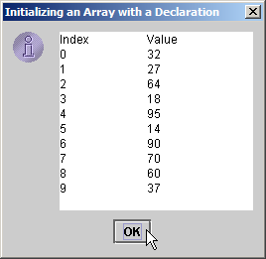
Output

Slide 47
Examples Using Arrays (cont)
1 import javax.swing.*;
2 public class Histogram {
3 public static void main(String[] args) {
4 int[] array = { 19, 3, 15, 7, 11, 9, 13, 5, 17, 1 };
5 String output = "Element\tValue\tHistogram";
6 // for each array element, output a bar in histogram
7 for (int counter = 0; counter < array.length; counter++) {
8 output += "\n" + counter + "\t" + array[counter] + "\t";
9 // print bar of asterisks
10 for (int stars = 0; stars < array[counter]; stars++ ) {
11 output += "*“;
12 } // end inner for
13 } // end outer for
14 JTextArea outputArea = new JTextArea();
15 outputArea.setText(output);
16 JOptionPane.showMessageDialog( null, outputArea,
17 "Histogram Printing Program", OptionPane.INFORMATION_MESSAGE);
18 System.exit( 0 );
19 } // end main
20 } // end class Histogram
Notes:
Line 4: Declare array with initializer list
Line 11: For each array element, print associated number of asterisks

Slide 48
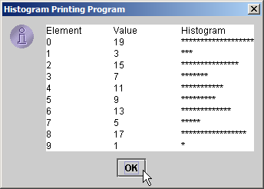
Output

Slide 49
Multidimensional Arrays
Multidimensional arrays
  Tables with rows and columns
    Two-dimensional array
    Declaring two-dimensional array b[2][2]
    int[][] b = { { 1, 2 }, { 3, 4 } };
      1 and 2 initialize b[0][0] and b[0][1]
      3 and 4 initialize b[1][0] and b[1][1]
    3-by-4 array
    int[][] b;
    b = new int[3][4];

Slide 50
Two-dimensional array structure
Column 0
Column 1
Column 2
Column 3
Row 0
a[ 0 ][ 0 ]
a[ 0 ][ 1 ]
a[ 0 ][ 2 ]
a[ 0 ][ 3 ]
Row 1
a[ 1 ][ 0 ]
a[ 1 ][ 1 ]
a[ 1 ][ 2 ]
a[ 1 ][ 3 ]
Row 2
a[ 2 ][ 0 ]
a[ 2 ][ 1 ]
a[ 2 ][ 2 ]
a[ 2 ][ 3 ]
Column index
Row index
Array name

Slide 51
Example
public class MultidimensionArrayDemo {
public static void main(String[] args){
String[][] names = {{"Mr. ", "Mrs. ", "Ms. "},
{"Smith", "Jones"}};
System.out.println(names[0][0] + names[1][0]);
System.out.println(names[0][2] + names[1][1]);
}
}
The output from this program is:
Mr. Smith
Ms. Jones

Slide 52
Summary
An array is a container object that holds a fixed number of values of a single type.
The length of an array is established when the array is created.
After creation, its length is fixed.

Slide 53
Session 4: Parameter

Slide 54
Parameters
Parameters is variable that declare in the method definition.
Parameters are always classified as "variables" not "fields".
Also called arguments.

Slide 55
Value and Reference Parameters
Two ways to pass arguments to methods
  Pass-by-value
    Copy of argument’s value is passed to called method
    In Java, every primitive is pass-by-value
  Pass-by-reference
    Caller gives called method direct access to caller’s data
    Called method can manipulate this data
    Improved performance over pass-by-value
    In Java, every object is pass-by-reference
      In Java, arrays are objects
        Therefore, arrays are passed to methods by reference

Slide 56
Passing Arrays to Methods
To pass an array argument to a method
  Create a method
    public void modifyArray(int[] arr)
  Array hourlyTemperatures is declared as
  int[] hourlyTemperatures = new int[24];
  Passes array hourlyTemperatures to method modifyArray
  modifyArray(hourlyTemperatures);

Slide 57
Example
1 // PassArray.java
2 // Passing arrays and individual array elements to methods.
3 import java.awt.Container;
4 import javax.swing.*;
5
6 public class PassArray extends JApplet {
7
8 // initialize applet
9 public void init()
10 {
11 JTextArea outputArea = new JTextArea();
12 Container container = getContentPane();
13 container.add( outputArea );
14
15 int array[] = { 1, 2, 3, 4, 5 };
16
17 String output = "Effects of passing entire array by reference:\n" +
18 "The values of the original array are:\n";
19
20 // append original array elements to String output
21 for ( int counter = 0; counter < array.length; counter++ )
22 output += " " + array[ counter ];
23
24 modifyArray( array ); // array passed by reference
25
26 output += "\n\nThe values of the modified array are:\n";
27
Notes:
Line 15: Declare 5-int array with initializer list
Line 24: Pass array by reference to method modifyArray

Slide 58
Example (cont)
28 // append modified array elements to String output
29 for ( int counter = 0; counter < array.length; counter++ )
30 output += " " + array[ counter ];
31
32 output += "\n\nEffects of passing array element by value:\n" +
33 "array[3] before modifyElement: " + array[ 3 ];
34
35 modifyElement( array[ 3 ] ); // attempt to modify array[ 3 ]
36
37 output += "\narray[3] after modifyElement: " + array[ 3 ];
38 outputArea.setText( output );
39
40 } // end method init
41
42 // multiply each element of an array by 2
43 public void modifyArray( int array2[] )
44 {
45 for ( int counter = 0; counter < array2.length; counter++ )
46 array2[ counter ] *= 2;
47 }
48
49 // multiply argument by 2
50 public void modifyElement( int element )
51 {
52 element *= 2;
53 }
54
55 } // end class PassArray
Notes:
Line 35: Pass array[3] by value to method modifyElement
Lines 43-47: Method modifyArray manipulates the array directly
Lines 50-53: Method modifyElement manipulates a primitive’s copy
Lines 52: The original primitive is left unmodified

Slide 59
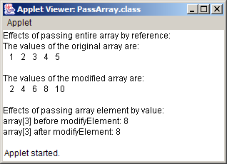
Output
The object passed-by-reference is modified
The primitive passed-by-value is unmodified
Notes:
Show the difference between value and reference parameters

Slide 60
Summary
Parameters is variable that declare in the method definition.
Every primitive is pass-by-value
Every object is pass-by-reference

Slide 61
Session 5: String

Slide 62
Java Strings
String is a Class
Strings are Constants
Declaration:
  String greeting = "Hello world!";
  char[] helloArray = { 'h', 'e', 'l', 'l', 'o', '.'};
  String helloString = new String(helloArray);
Notes:
Note: The String class is immutable, so that once it is created a String object cannot be changed. The String class has a number of methods, some of which will be discussed below, that appear to modify strings. Since strings are immutable, what these methods really do is create and return a new string that contains the result of the operation.

Slide 63
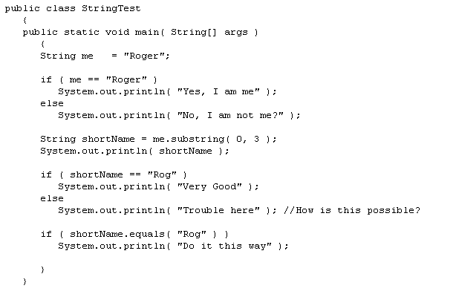
String equality
Comparing string is done via its equal() method, not by == operator

Slide 64
Concatenating Strings
The String class includes a method for concatenating two strings:
string1.concat(string2);
This returns a new string that is string1 with string2 added to it at the end.
Strings are more commonly concatenated with the + operator, as in
"Hello," + " world" + "!"
which results in
"Hello, world!"
Notes:
Look at Java API doc for more detailed about String class

Slide 65
Summary
Strings are a sequence of characters and are widely used in Java programming.
In the Java programming language, strings are objects. The String class has over 60 methods and 13 constructors.
Use equal() method, not ==
There are many ways to concatena string

Slide 66
Session 6: Flow Control

Slide 67
Control Flow
All application development environments provide a decision making process called control flow statements that direct the application execution.
Flow control enables a developer to create an application that can examine the existing conditions, and decide a suitable course of action.
Loops or iteration are an important programming construct that can be used to repeatedly execute a set of actions.
Jump statements allow the program to execute in a non-linear fashion.

Slide 68
Control Flow Structures in Java
Decision-making
  if-else statement
  switch-case statement
Loops
  while loop
  do-while loop
  for loop
Branching
  break
  continue
  return

Slide 69
if-else statement
The if-else statement tests the result of a condition, and performs appropriate actions based on the result.
It can be used to route program execution through two different paths.
The format of an if-else statement is very simple and is given below:
if (condition) {
action1;
} else {
action2;
}
“Else” is optional
Alternative way to if-else is conditional operator ( ?: )

Slide 70
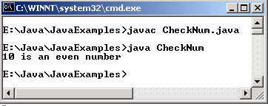
Example
class CheckNum {
public static void main(String[] args) {
int num = 10;
if (num % 2 == 0) {
System.out.println(num + " is an even number");
} else {
System.out.println(num + " is an odd number");
}
}
}

Slide 71
switch – case statement
The switch – case statement can be used in place of if-else-if statement.
It is used in situations where the expression being evaluated results in multiple values.
The use of the switch-case statement leads to simpler code, and better performance.

Slide 72
Example
public class SwitchDemo {
public static void main(String[] args) {
int month = 8;
String monthString;
switch (month) {
case 1: monthString = "January"; break;
case 2: monthString = "February"; break;
case 3: monthString = "March"; break;
case 4: monthString = "April"; break;
case 5: monthString = "May"; break;
case 6: monthString = "June"; break;
case 7: monthString = "July"; break;
case 8: monthString = "August"; break;
case 9: monthString = "September"; break;
case 10: monthString = "October"; break;
case 11: monthString = "November"; break;
case 12: monthString = "December"; break;
default: monthString = "Invalid month"; break;
}
System.out.println(monthString);
}
}
Output will be: August

Slide 73
while Loop
while loops are used for situations when a loop has to be executed as long as certain condition is True.
The number of times a loop is to be executed is not pre-determined, but depends on the condition.
The syntax is:
    while (condition) {
    action statements;
    }

Slide 74
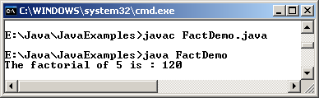
Example
class FactDemo {
public static void main(String[] args) {
int num = 5, fact = 1;
while (num >= 1) {
fact *= num;
num--;
}
System.out.println("The factorial of 5 is : " + fact);
}
}

Slide 75
do – while Loop
The do-while loop executes certain statements till the specified condition is True.
These loops are similar to the while loops, except that a do-while loop executes at least once, even if the specified condition is False. The syntax is:
    do {
    action statements;
    } while (condition);

Slide 76
Example
class DoWhileDemo {
public static void main(String[] args) {
int count = 1, sum = 0;
do {
sum += count;
count++;
} while (count <= 100);
System.out.println("The sum of first 100 numbers is : " + sum);
}
}
The sum of first 100 numbers is : 5050

Slide 77
for Loop
All loops have some common features: a counter variable that is initialized before the loop begins, a condition that tests the counter variable and a statement that modifies the value of the counter variable.
The for loop provides a compact format for incorporating these features.
Syntax:
for (initialization; loopContinuationCondition; increment) {
statement;
}

Slide 78
Example
class ForDemo {
public static void main(String[] args) {
int count = 1, sum = 0;
for (count = 1; count <= 10; count += 2) {
sum += count;
}
System.out.println("The sum of first 5 odd numbers is : " + sum);
}
}
The sum of first 5 odd numbers is : 25

Slide 79
Break Statements
The break statement has two forms: labeled and unlabeled.
Use unlabeled break to terminate a switch, for, while, or do-while loop
Use labeled break to terminates an outer statement

Slide 80
Unlabeled Break Example
class BreakDemo {
public static void main(String [] args) {
for (int count = 1; count <= 100; count++) {
if (count == 10) {
break;
}
System.out.println("The value of num is : " + count);
}
System.out.println("The loop is over");
}
}
Notes:
When the count variable equal 10, the break statement will stop the for loop at this time and then go to the next statement after the for loop. So, all loop with count from 10 to 100 will be not performed.

Slide 81
Output
The value of num is : 1
The value of num is : 2
The value of num is : 3
The value of num is : 4
The value of num is : 5
The value of num is : 6
The value of num is : 7
The value of num is : 8
The value of num is : 9
The loop is over

Slide 82
Continue statement
The continue statement skips the current iteration of a for, while , or do-while loop.
The unlabeled form skips to the end of the innermost loop's body and evaluates the boolean expression that controls the loop.
The labeled continue statement skips the current iteration of an outer loop marked with the given label.

Slide 83
Unlabeled Continue example
class ContinueDemo {
public static void main(String[] args) {
String searchMe = "peter piper picked a peck of pickled peppers";
int max = searchMe.length();
int numPs = 0;
for (int i = 0; i < max; i++) {
//interested only in p's
if (searchMe.charAt(i) != 'p') {
continue;
}
//process p's
numPs++;
}
System.out.println("Found " + numPs + " p's in the string.");
}
}
Here is the output of this program: Found 9 p's in the string.
Notes:
This program steps through a String, counting the occurences of the letter "p". If the current character is not a "p", the continue statement skips the rest of the loop and proceeds to the next character. If it is a "p", the program increments the letter count.

Slide 84
Return statement
The return statement exits from the current method, and control flow returns to where the method was invoked.
The return statement has two forms:
  Returns a value: return ++count;
  Doesn't returns a value (void): return;
The data type of the returned value must match the type of the method's declared return value.

Slide 85
Summary
Decision-making
  if-else statement
  switch-case statement
Loops
  while loop
  do-while loop
  for loop
Branching
  break
  continue
  return

Slide 86
Q & A

